Slide 1


Slide 2

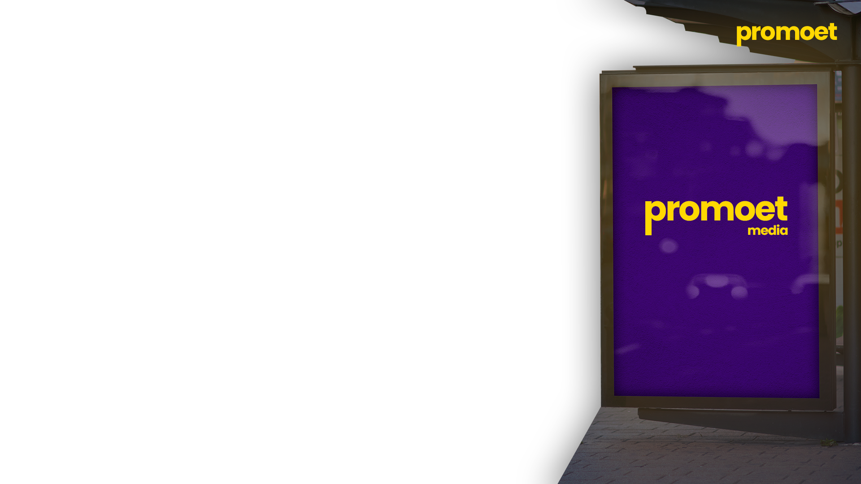
Who are we?
We are advertising partners to brands, Local and National, respectively.
We provide Advertising Solutions to Brands using Digital Out-of-Home Advertising.

Slide 3
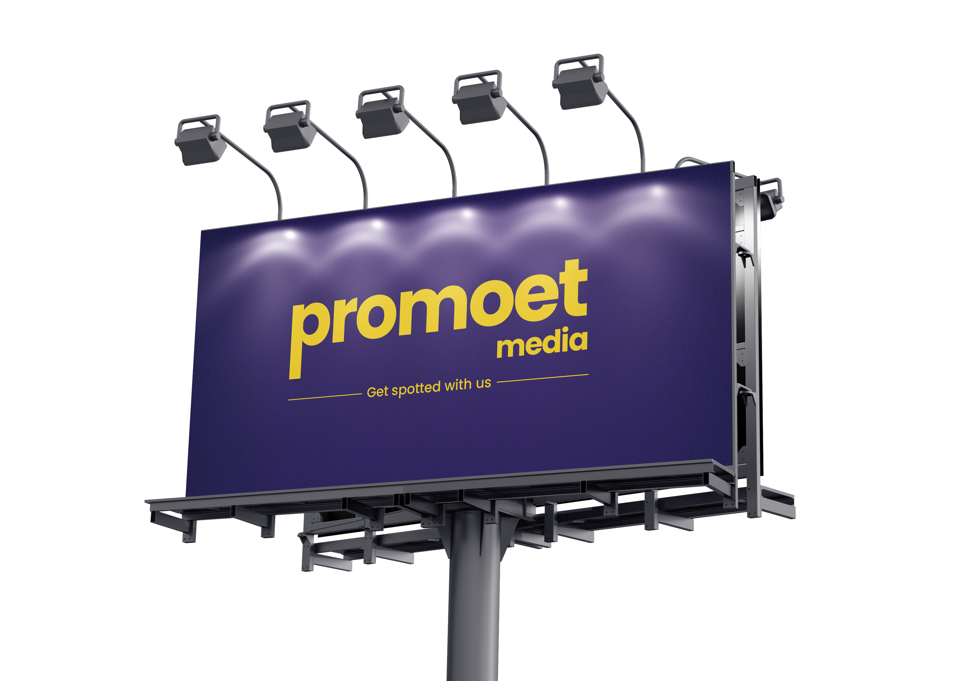
Understanding DOOH
Digital outdoor advertising is the use of digital screens to stand out between the cluttered space of traditional old posters and offer a next generation solution in outdoor advertising space. The idea is to offer better quality to the client, gaining more attention from the public and in result offering more value to clients and viewers.
Examples:
Road-side dynamic displays of car ads (often in locations having a showroom of the brand nearby)
Food chain offers on ads played in or near a mall’s food court
A dynamic display of hotels advertisements played on screens in airport arrival halls.

Slide 4
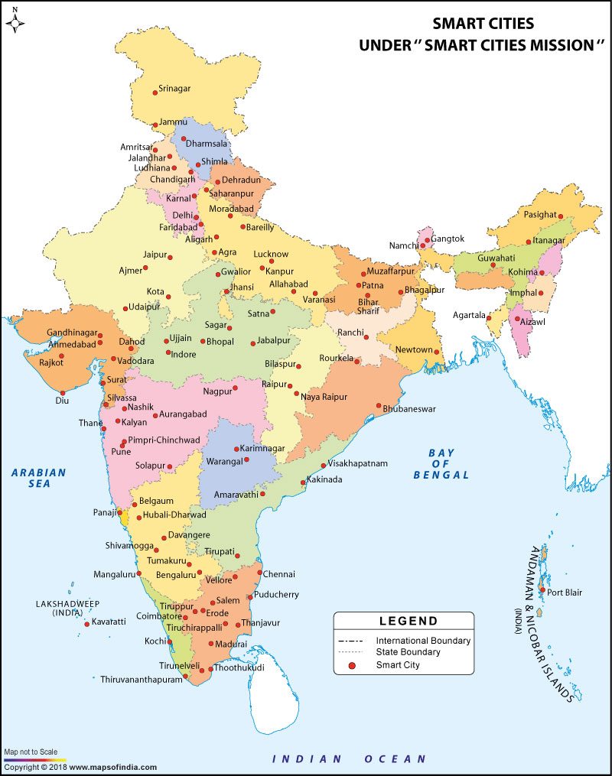
The Problem
Government's initiative to develop 100 smart cities starting from 2019 has pushed a lot of rural population to shift to tier 3 cities for better opportunities. This will eventually lead to creation of a new middle class in these cities. This possibility is being recognized by brands. Many new brands are planning to enter small tier 3 cities.
For example, Brands like West Side, Reliance Trends, Swiggy, Zomato have already entered Sagar. Brands like Zudio, Dmart, are in process.
This creates a massive opportunity in many companies. We have identified an opportunity in the space of digital outdoor advertising.

Slide 5

The Solution
With infusion of money in Tier 3 cities, Income level of people and their standard of living will increase. This will create a potential market for brands.
Firstly, we aim to utilise this market by providing them with a platform to introduce and market themselves.
Secondly, there is a marketing gap in tier-3 cities and rural areas between national brands and local consumers, we would like to fill this gap.

Slide 6
Market Size and Growth
The global DOOH market is projected to reach USD 31.7 billion annually by 2025.
At the same time, DOOH trends show the amount of screen real estate could grow from about 38 million connected displays in 2018 to 87 million worldwide by 2021.
The opportunity for media networks and their advertisers to make an impact with the latest digital signage technologies is enormous.

Slide 7


Benefits Over Traditional Advertising
Increased attention : Digital screens provide better presence than all its competitors in the market like Print Hoardings, physical posters etc. Placed in high-traffic areas can be seen by thousands or even millions of people every day.
Better Real Estate Utility : Offering the same space to multiple clients and charging exclusive rates for the same.
Targeted Reach : DOOH advertising can also be targeted to specific geographic areas, such as neighborhoods or shopping districts, or to specific audiences, such as commuters or sports fans. This can help businesses reach the people most likely to be interested in their products or services.

Slide 8
Problems with DOOH
Problems in calculating impact over digital marketing , we tend to solve this problem in future by integrating AI to our software.

Slide 9
Revenue Model
Collaboration with Government (Expense)
The revenue model that we are focusing on is Tender based Revenue Sharing Model. An annual fee is paid in exchange for commercial access to the VMS System.

Slide 10
Collaboration with Sponsors (Income)
Advertising Revenue : We aim to generate revenue by selling ad space on our screens to local and national advertisers. Subscription Model: The DOOH company can also offer a subscription model to local businesses that want to display their ads on the screens regularly. This can provide a stable and predictable revenue stream.
Content Creation : The company can offer content creation services to us as we have expertise in the field. For that we can charge a fee from them. These ads can further be broadcasted on screens as well as on digital platforms.
Data Analytics : Creating a backend data analytic center to collect responses for ads being broadcasted on various platforms.
Partnerships : Exploring Partnerships with local businesses like restaurants and broadcasting our ads on their screen.

Slide 11
Fundamentals of Revenue Model
Our research and analyses suggest that with the help of VMS, we would be able to reach audience throughout the city as the screens are present in all the places.
By Running Numbers, we figured out, That we would be able to display 5 second static ads and play them around at least 500 times a day.
That too at a fair amount, making it accessible for local business, small business to be presented with national companies.
The average Cost of an impression is around Rs. 0.66/Impression for a particular brand at an average monthly price of Rs.10000/Month.

Slide 12
Our Long-Term Vision
With DOOH, we would like to :
Expanding DOOH in Central India :
We plan to expand in other tier-3 cities as well.
Integrating AI in DOOH:
We want to create a cloud-based software, as well as an integrated impact calculating AI.

Slide 13
Current Status
We are engaged in market research, confirming the locations and in the registration process. Expected date of completion : Mar 20, 2023
Interaction with previous/ existing people in the Industry:
Sanket Kathal
Anant Advertising
Interacting with Prospects:
Badkul TVS
Luminous
Westside
Reliance Trends
Locations and Licencing:
Kesharwani Building - Katra Bazaar
Chhavani Parishad Sagar – Mall, Etc

